Slide 1

Research, Student Scholarship and Beyond: My Academic Journey
Liam Hart
Department of Psychology
Grand Valley State University
Notes:
Hi my name is Liam Hart. Today, I am going to talk about the research opportunities I found at Grand Valley that have helped me find my path in psychology. I would like to start by saying that there are a lot of things I didn’t understand about this field at first, and I am certainly still learning… but, things become much clearer as you spend more time in research, or whatever side of psychology you choose.

Slide 2
Why is Research Experience Important?
Master’s: unfunded, 2-3 years
Goal: psychology professional
Work experience is more important than research experience
Get an internship (Psychology Practicum: PSY 490)
PhD: funded, 4-6 years
Goal: psychology researcher
Research experience is extremely important
Mentorship from faculty is invaluable
Notes:
I would like to start off talking about why research experience is important, more specifically who it is important for – for most of my time at Grand Valley, I did not know about any of this, which is why I want to talk about it. The career path of someone with bachelors degree in psychology is not like that of others such as accounting, which provides a clear path to becoming an accountant, or computer science, where it is clear that you are learning skills to work in something like a software development. Psychology is more like pre-med in that most of the classes function to prepare you for graduate school because they provide an overview of research findings and research methodologies instead of teaching employable skills like programming or tax regulations and laws (like in accounting and computer science). There are many options for those looking for jobs with an undergraduate in psychology, such as HR, sales, marketing, etc… but, they probably don’t fall in the realm of psychology (which does not mean that you can’t be successful in those jobs). To have the title “psychologist”, further education is generally required, and that usually means a Master’s or a PhD. The right choice for you depends on your career and life goals.
A PhD takes longer – however, any reputable program will be fully funded through grants and teaching assistantships, so up-front cost is less of an issue when compared with a Master’s. Still, there is an opportunity cost with a PhD; a few years of a salary job as a Master’s. So, if you want a professional job within your subfield of psychology quickly, a Master’s is the way to go. Research experience strengthens applications to Master’s programs, but so do internships; the Psychology Practicum (PSY 490) is a great way of getting this. Work experience is also more sought after by companies and organizations.
If your goal is to be a researcher and/or professor though, a PhD is the way. Research experience is absolutely essential, and so is faculty mentorship (which you get through working with faculty on their research). All Professors have a PhD, so their perspective and advisement during applications is extremely important, along with a great letter of recommendation.
I will say I “chose” to go the PhD route. But to be honest, I did not truly know what I was positioning myself for most of the time. I worked in research because I was told it would make me more competitive for grad school, which I knew was probably in my future. Like most people (I think), I did not understand how academia worked and the differences between academia and industry/professional jobs, so that is why I talked about it a bit before getting into my experience. Good news is that I am happy with where I am now, so I am going to talk about the steps that I took to make myself stand out as an emerging psychology researcher and strengthen my PhD applications.

Slide 3
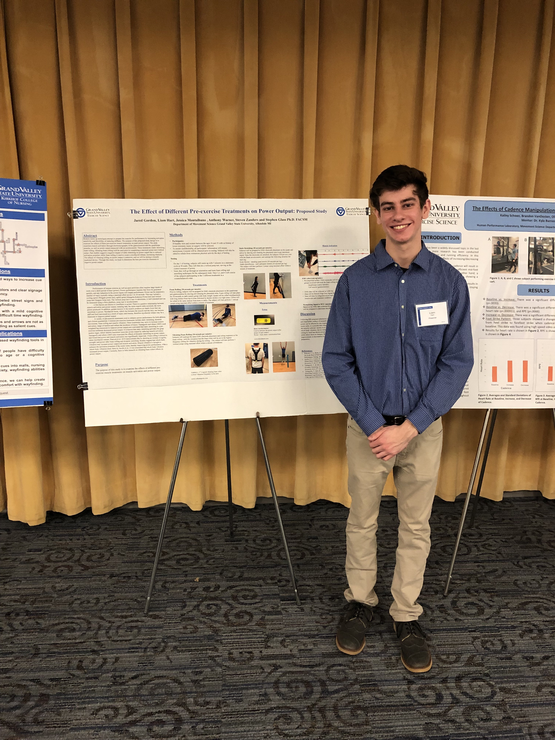
Freshman
Professor Steven Glass’s exercise science research lab
Measured muscle activation during exercise
IRB proposal, data collection, study protocols
Found interest in psychology through YouTube videos, Ted Talks, and podcasts
Psychology, neuroscience, and philosophy of mind
Meditation and psychedelics
Very broad
Notes:
I entered Grand Valley as an undecided major. At my freshman orientation, I heard Dr. Steven Glass talk about the value of undergraduate research and that Grand Valley had particularly good opportunities to get research experience. So, I cold-emailed him in the first month I was there asking about this so-called research experience and where I could get some, and he graciously invited me to join his exercise science lab. I found the topic interesting, so I was excited to join. We measured muscle activation using electrodes as subjects performed various exercises, and I got experience writing IRB proposals, abstracts, collecting data and carrying out study protocols.
I even got to be one of the presenters for our poster at student scholars day: the effect of different pre-exercise treatments on power output.
By the end of my freshman year, though, I had declared psychology as my major. However, after listening to many Ted Talks and podcasts, I found that I was most interested in psychology, neuroscience, philosophy of mind, and meditation and psychedelics. In hopes of being one of those people that give a Ted Talk one day, psychology seemed to be the best fit to blend all of those areas together.

Slide 4
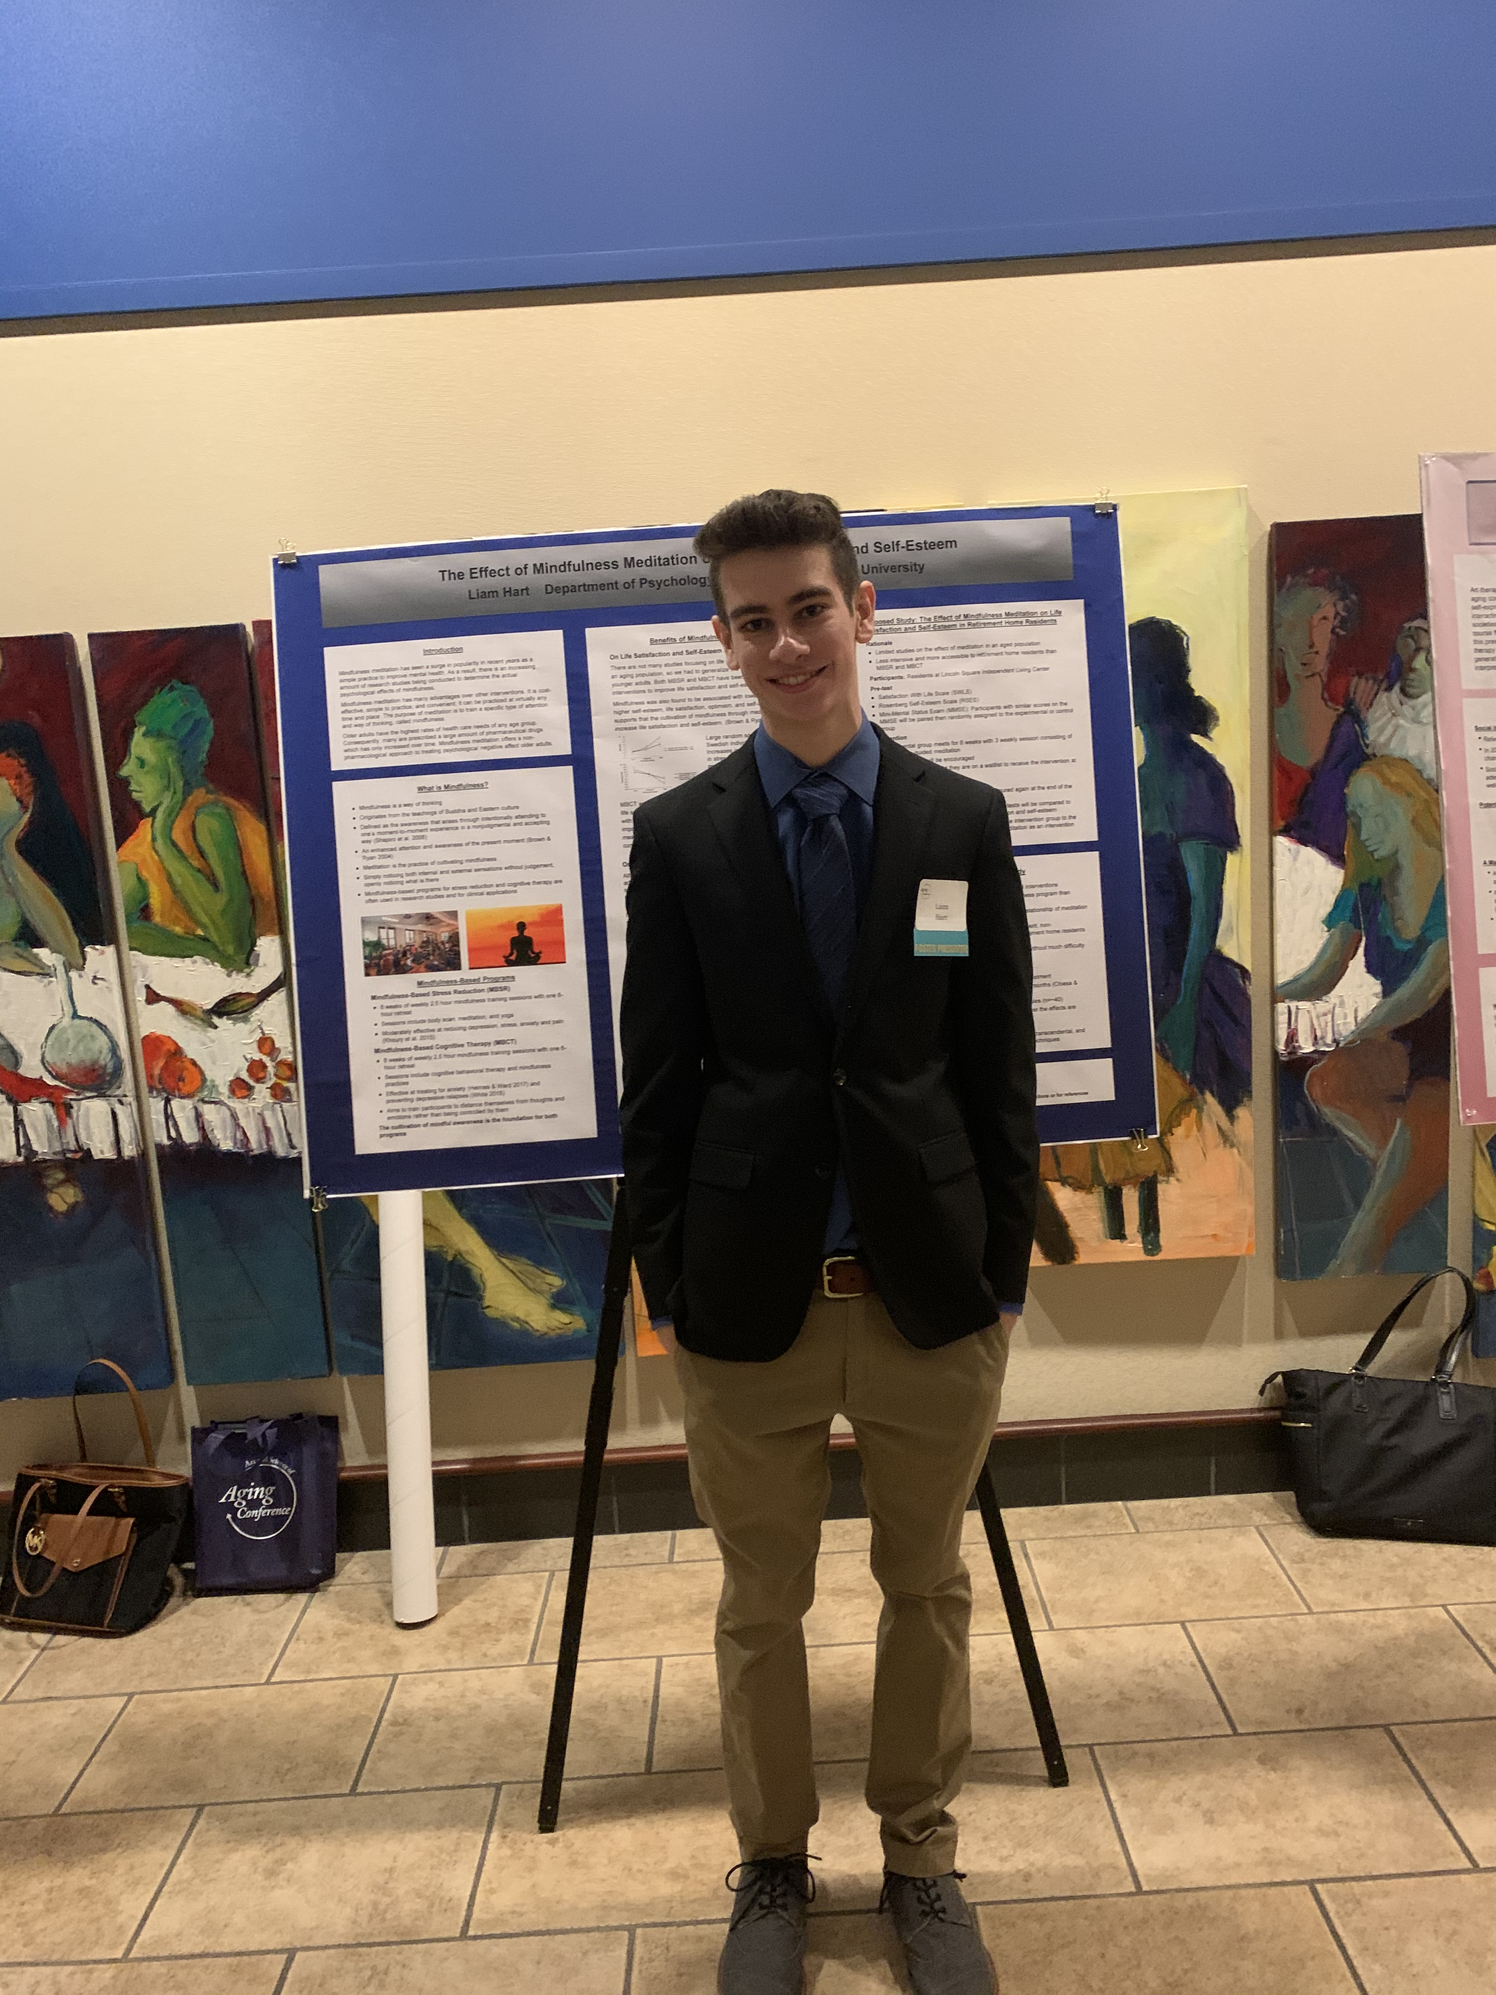
Sophomore
Perspectives on Aging with Professor Jing Chen
Wisdom
Meditation
Intermittent fasting
PSY 499 and PSY 399
Work on research project for course credit
1-on-1 meetings with professor and email
Notes:
In my first year as a psychology major, I took Perspectives on Aging with Jing Chen. I was very interested in few of the research topics we discussed in class such as the cultivation of wisdom, meditation, and intermittent fasting, so I often stayed after class to talk with Jing about them in further detail.
By the end of the class, she invited me to take PSY 399 or 499 with her and start a research project investigating effects of meditation. For those of you that don’t know, PSY 399 is independent reading and PSY 499 is independent research. Essentially, you can do research in exchange for course credit, which is great because it allows you to gain research experience and mentorship from a professor without time commitment on top of a full class schedule. Jing and I came up with a proposal for a pilot study that would investigate the effect of mindfulness meditation on life satisfaction and self-esteem in older adults. It was my project, but she provided the necessary guidance on the project, which of course substantial as I had no idea what I was doing.

Slide 5
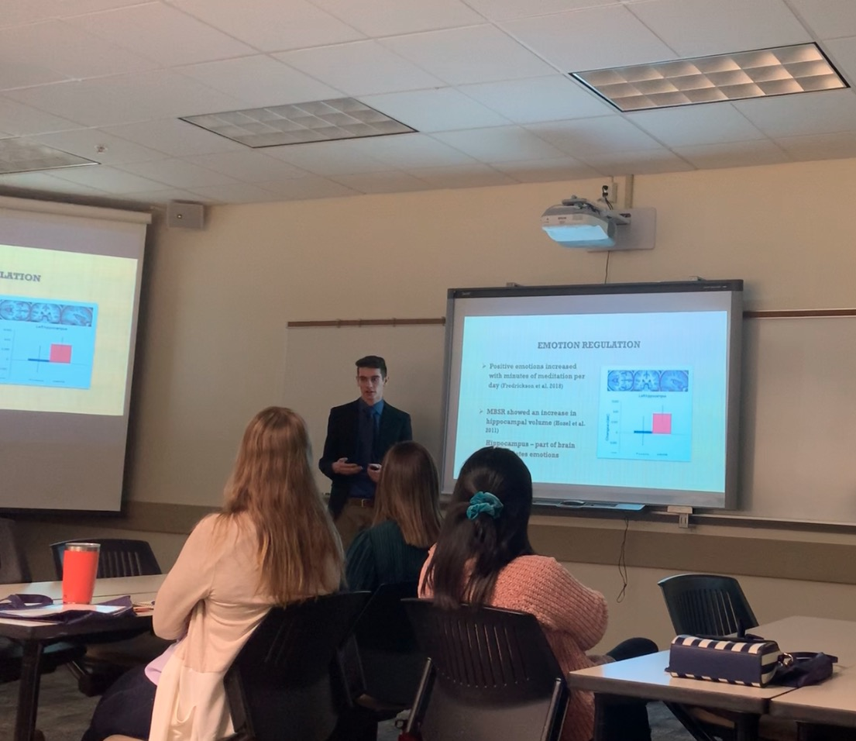
Art and Science of Aging Conference
First oral presentation!
Notes:
I also gave a 5-minute presentation on the study proposal at the Art and Science of Aging Conference

Slide 6
COVID-19! Meditation study ended ☹ New project: Can a course on aging with a service-learning component change students’ attitudes toward aging?
Notes:
Unfortunately, this study ended with the pandemic in March. Still, I the experience of creating a study proposal, getting IRB approval, and presenting it at a conference was extremely valuable.
Later on, Jing and I would start analyzing data she had collected and begin writing a manuscript that investigated effectiveness of a course design with a service-learning project on reducing ageism in students.

Slide 7
Junior
Psi Chi student board
Social Cognition Lab (Professors Michael Wolfe and Todd Williams)
Watched Ted Talk
Read their most recent article
Sent email indicating interest (and that I did my homework on their work)
Professor Wolfe sent articles to read
McNamara and Magliano (2009)
Notes:
At the start of my junior year, I felt that I had kinda figured out how to succeed in college and study efficiently. So, I reached out to Todd Williams, one of the faculty advisors for Psi Chi, and inquired if there was anything I could do help out on the Psi Chi student board. He invited me to the next meeting, and afterwards I talked with him about my growing interest in cognitive psychology research. He recommended that I reach out to Professor Michael Wolfe about his research regarding beliefs and our awareness of them. He sent me his Ted Talk and his most recent article, and encouraged me to send Mike an email. So, I watched the talk, read the paper, and sent an email. I made sure to include a couple questions about the research study to show that I had actually read and understood it. Soon after, we met and discussed the article and their research, and he sent me a couple more articles to me so I could get up to speed on the research area. One of my most memorable moments from my research experience was opening up one of these attachments for a paper Mike sent only to find McNamara and Magliano (2009), an 89 page extremely dense book chapter. I could not believe it. I am sure many of you can relate to this, but I had to put 100% effort and focus into reading a 30-page article. 89 pages was so daunting, but I got it done and am better for it!

Slide 8
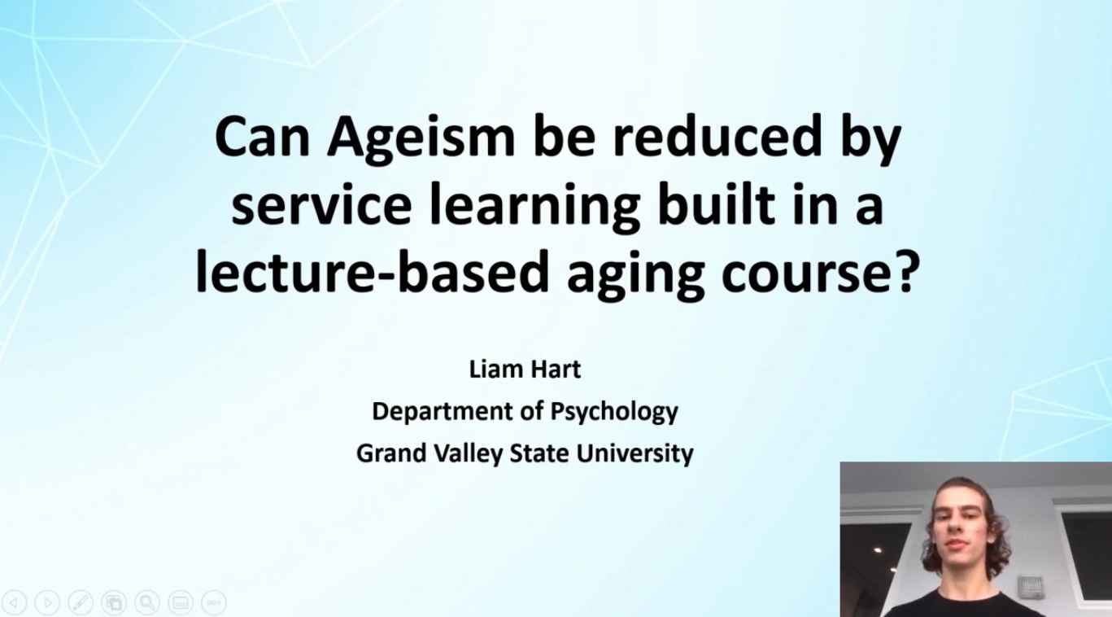
Notes:
I also gave a virtual presentation at Students Scholars Day 2021 for that project Jing and I had been working on. As you can see, it is literally the same background as this presentation. Nice bonus about giving presentations is that you at least have a format to work with for later presentations.

Slide 9
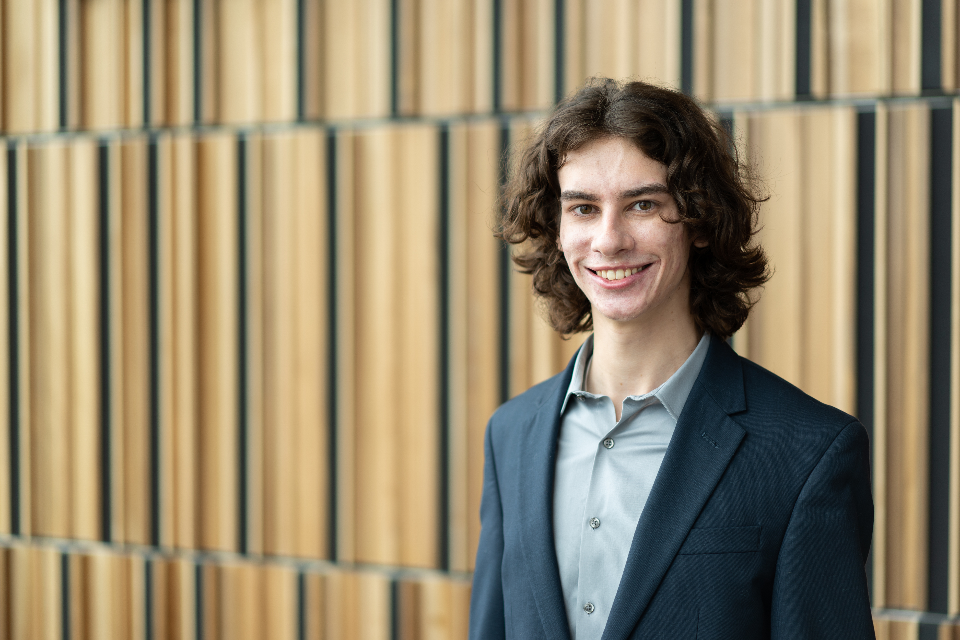
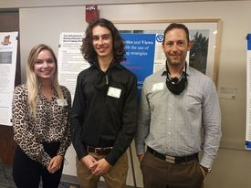
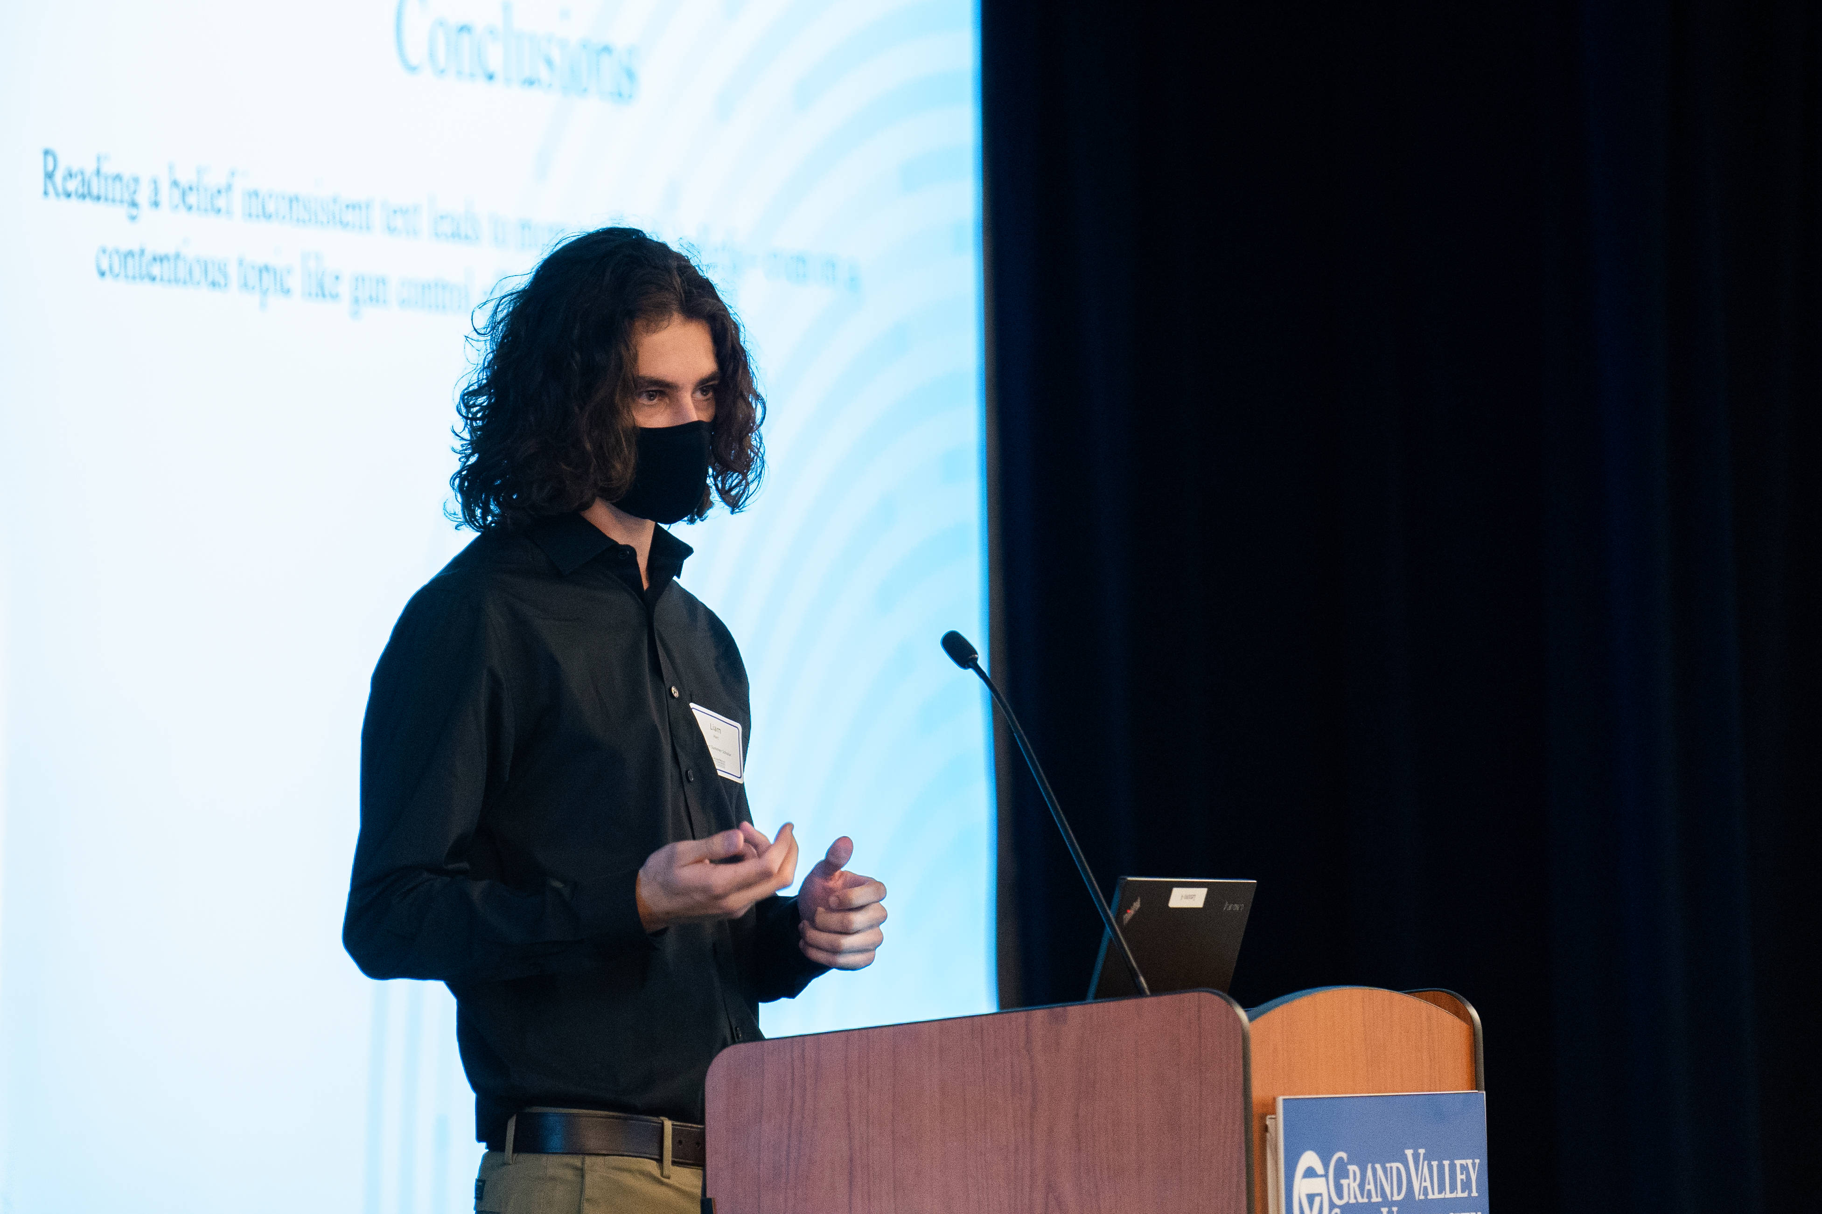
Student Summer Scholars (S3)
Office of Undergraduate Research and Scholarship (OURS)
$5000 stipend to work on research during the summer
30 hrs/wk
Final research paper and presentation
Solidifies relationship with mentor(s)
Notes:
Only a month or two after we started working together, Mike asked me if I wanted to apply for the Student Summer Scholars research program. Quick overview of what that is: if your application is accepted, CUSE gives you a $5000 stipend to work on research for 30 hours per week during the summer. Since most of us do research on a volunteer basis already, this is a fantastic deal and looks great on grad school applications too. There are also professional development activities like writing workshops that are part of the program and at the end you write a final research paper and present your findings at the Student Summer Scholars showcase. The whole thing is structured to simulate the research process, with the final paper being a submission of an actual manuscript to an academic journal and the showcase being like an academic conference, similar to SSD. One of the most important aspects of being a part of S3, though, is that you solidify your relationship with your mentor and have the opportunity to meaningfully contribute to their research. The research experience is great, but the mentorship a professor can provide for graduate school applications and beyond is priceless.

Slide 10
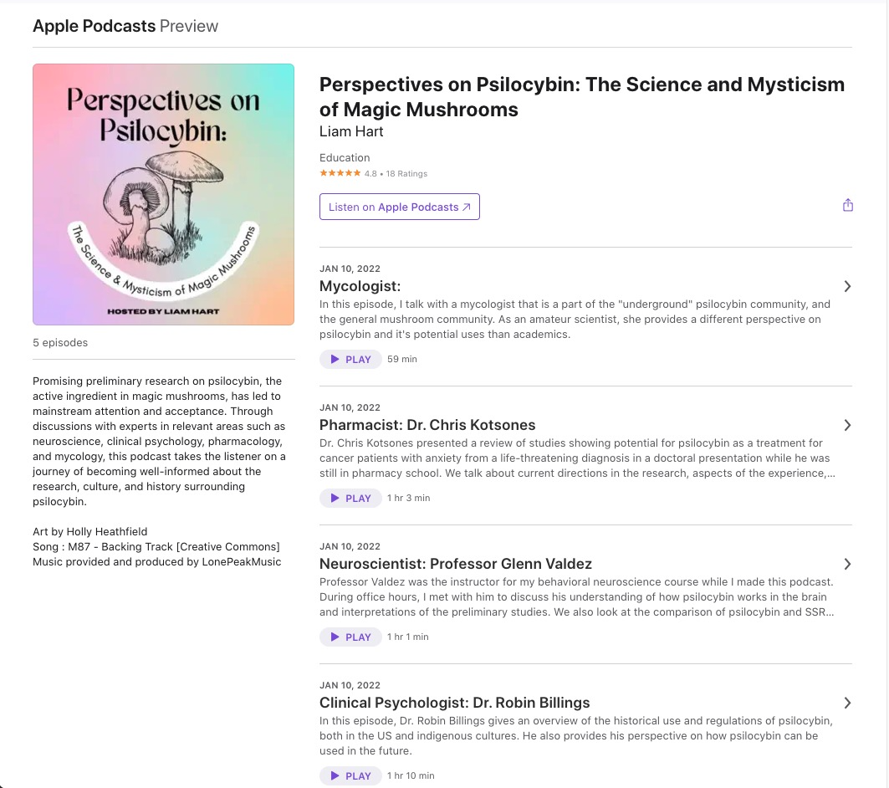
Senior
Honors Senior Project
Podcast discussing research on psychedelic substances
Enabled by research experience
Continued psychology research
Notes:
I came into Grand Valley with some AP credits, so my “senior year” was only one semester. I continued on with the research projects in the Social Cognition Lab, but I felt my main accomplishment was my honors senior project, which is a podcast in which I discuss the recent research which shows preliminary evidence that psychedelic substances may be effective treatments for certain mental disorders such as depression, anxiety, addiction, PTSD, and potentially others. I had a few expert guests, namely Glenn Valdez who is a neuroscience professor here at Grand Valley. As I talked about at the beginning, this research was one of the primary reasons that I chose psychology as my major. This podcast allowed me to contribute to the conversation and play a role in reducing the stigma and misconceptions about psychedelic substances. I am actually quite happy with how it turned out – I know for a fact that I could not have done this topic justice without my experience reading research papers and understanding how to communicate research simply but accurately. It actually could have been quite bad and misinformative if I did not have this understanding.

Slide 11
Gap Year(s)
Worked at Planet Rock Climbing Gym Jan 2022
Poster presentation at Midwest Psychological Association Apr 2022
Oral presentation at Society for Text and Discourse Jul 2022
First authorship on manuscript published in Educational Gerontology Jan 2023
Author on manuscript submitted to Acta Psychologica Feb 2023
First authorship on manuscript submitted to Instructional Science Apr 2023
Starting as research project coordinator at Henry Ford Health Apr 2023
Applying to Human Factors Psychology PhD Programs Dec 2023
Notes:
After my senior year, I moved home and took a gap year to gain more experience and finish the research projects I had been working on. This is the timeline, which is actually quite full even though I was not a student – I got a job at a climbing gym while continuing on with research. A lot of people think a gap year can only be detrimental to your academics and career, but that is definitely not true - my greatest academic accomplishments have actually been during my gap year and while I was a student. However, it is essential that you remain productive in psychology – you can’t just work at a rock climbing gym and not do research.

Slide 12
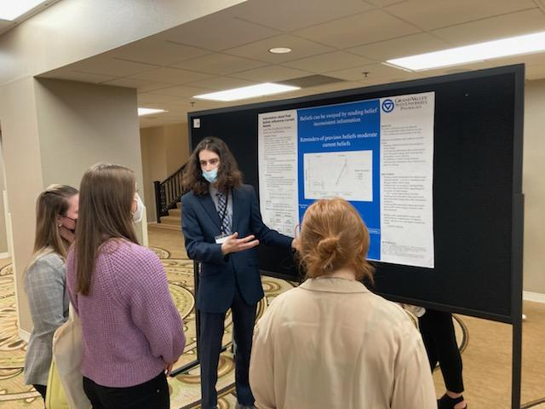
MPA
Notes:
Here is me ”in action” at the conference. This was my first big psychology conference experience

Slide 13

Society for Text & Discourse
Notes:
I also gave an oral presentation virtually at the Society for Text and Discourse Conference which was great because I got another recorded presentation out of it and got to make connections with some first-year PhD students. Both of these conferences were a big step up from things like student scholar’s day but I felt I was ready for this because of all that practice from SSD and S3.

Slide 14
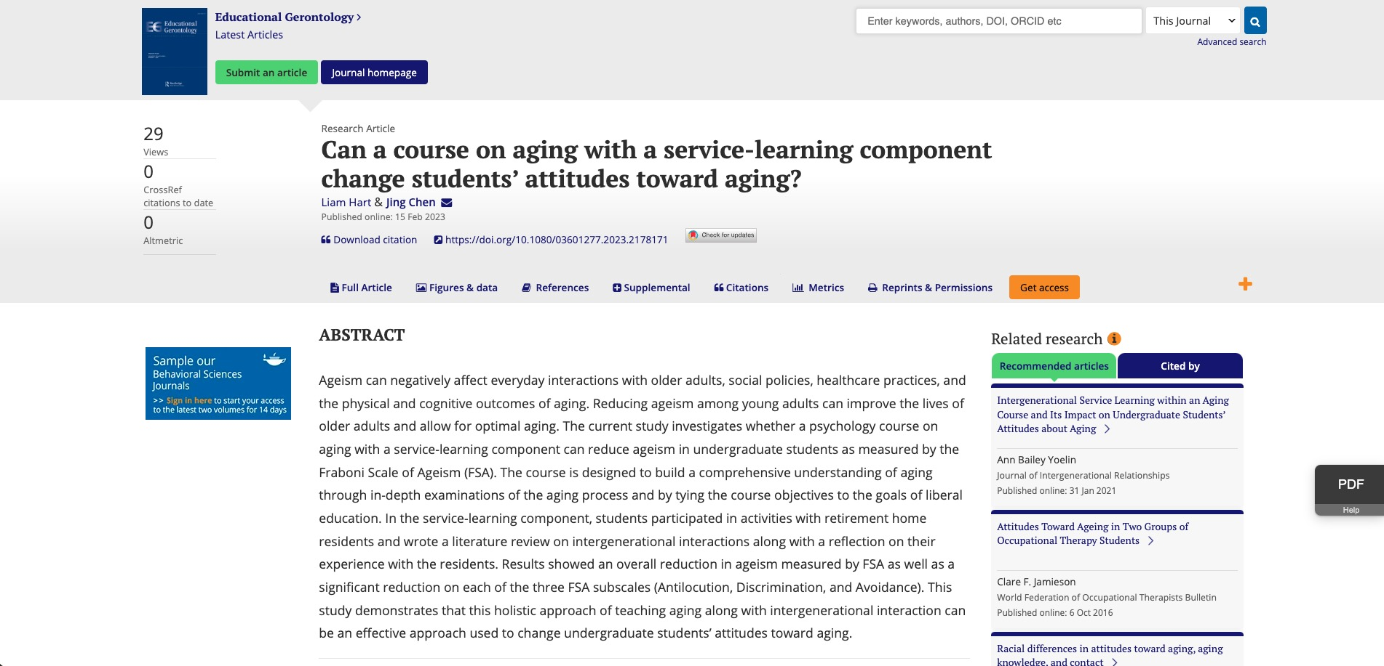
First authorship
Notes:
More recently, I got my first publication with Jing Chen in Educational Gerontology, a paper titled “Can a course on aging with a service-learning component change students’ attitudes toward aging?”. I also have two manuscripts that are submitted and pending review: “Verification of Past Beliefs Moderates Belief Change”, on which I am the fourth author, and “Beliefs Influence Argumentative Writing”, on which I am the first author.

Slide 15

Research Project Coordinator
Notes:
Finally, I will be starting as a research project coordinator at Henry Ford Health on the 24th of this month. This will be my first big boy job, and I am certain that it was my research experience that got me in the door. This will allow me to function in a research position full-time while also getting paid.

Slide 16
Key Takeaways
Notes:
Okay, so that is my academic journey up to now. Now I will talk about what I learned and what I would tell myself if I could go back in time to freshman year.

Slide 17
Watch Talk, Read Paper, Indicate Interest
Want to join a research lab?
It is on YOU to show your worth
GVSU is not ivy league
Opportunities to take a larger role in research
Network with faculty
First authorship
Single best thing you can have on PhD application
Work hard on one project for a long time (~2 years)
Notes:
So, how do you become involved in undergraduate research? First thing is that you have to engage with faculty in any way you can. This may entail talking to your professors after class about the course material if it is interesting to you, a specific field or line of research in psychology that interests you, or questions or clarifications about the research that the professor does. This shows your intrinsic interest in the subject of psychology, which is what professors are looking for in potential research assistants because it suggests you are motivated. The way I would recommend going about this is by looking at the psychology faculty section of the GVSU website and finding those that do research that interests you. When you have found a professor that you want to work with, you need to do these 3 steps when contacting them: watch talk, read paper, and indicate interest. Okay, maybe they don’t have a talk, but you need to become familiar with the research they have done. Best bet is to read a few of their abstracts and read one of their papers that interests you in depth – this will allow you to generate good, specific questions for them and be able to talk about the specifics of their research to some degree. I would focus on the methods and discussion sections for generating questions, but they are all important. Once you have a few comments and questions you are happy with, reach out to them over email and express your interest in their research, show that you have done your homework on their work, and ask for a meeting, at the end of which you can ask about open research positions. What you absolutely SHOULD NOT do if you are trying to work on research is send a mass email to all psychology professors; this will have the opposite effect.
Grand Valley is not an Ivy League or R1 research institution – use this to your advantage. Most of the research labs here are not getting huge grants with an army of grad students to carry out research. However, GV has numerous advantages over these schools. The first thing is less competition – you are not going up against the kid that won the math contest, spelling b, and is a chess grandmaster. It is easier to stand out. Additionally, there are more opportunities for direct faculty mentorship. We can have advising meetings with faculty and do research and get mentored by them; in the big research institutions, it is often grad students doing this. There are also more opportunities to take larger roles in research projects, which can strengthen applications and your skillset. It is completely possible here to get a first-name publication – that would be very unusual at a Harvard-type university. Finally, you can become fully involved in the research culture at GV and build your network among other students and faculty, like through the S3 program. There is also a very good chance professors here will respond to your emails even if they don’t know you… as long as you put effort in and do your homework,. That is not the case at other universities. Finally, understand a psychology degree is what you make of it. The choices you make regarding psychology classes and other classes in your major and minor are going to give you skills that set you up for something. If research is your goal, statistics classes will definitely be helpful. Additionally, the type of research you do impacts this as well - working with a professor that does research on perception would not help as much in applications for a clinical program, but it would help you get into a human factors psychology program. Any research experience is MUCH better than none, but in a perfect world your undergraduate research is in the same subfield as your grad program.
I mentioned that I currently have one first author publication and another in progress. This looks really good on a CV and on applications because it shows my involvement in and commitment to research, and there is a significant difference between authorship and first-authorship. First authorship means that you get most of the credit for a publication because it means you did most of the work, including the writing and final organization, literature review, and you are usually involved in the initial conception of the study/experiment. Now, the initial conception of an experiment and the resulting publication takes a pretty long time – I would estimate at least two years and can often be longer. The key to having the opportunity for first-authorship is to work on one project for a long enough time so that you have a good grasp on the study design, results, relevant literature, and so that you have done enough work on it to where it makes sense for you to be first author. Conference presentations usually precede this. Now, if necessary, it can be important to work in a few research labs to figure out what area you like the most. But eventually it is important to stick with a lab for a while. I was able to get first authorship by taking a gap year – if I had not taken this time to focus on these research projects, that would not have happened.
Use this to your advantage (ivy league)

Slide 18
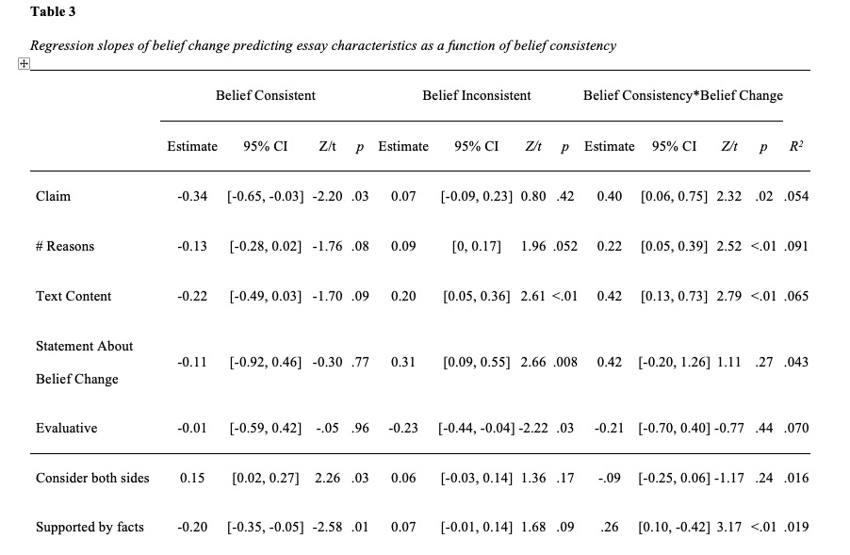
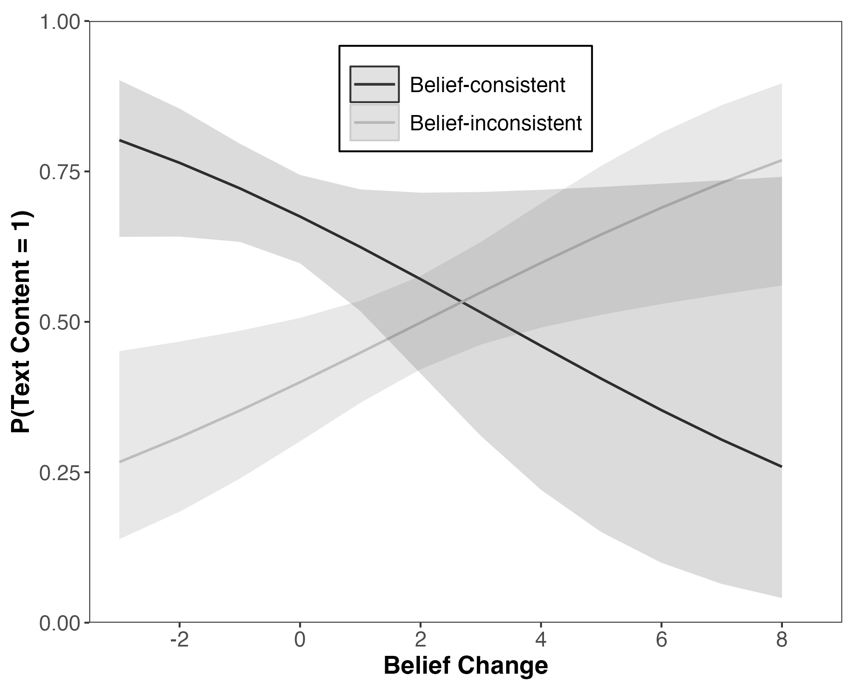
Statistics are Important
Essential part of research (in any discipline)
Statistical computing and programming
SPSS, Jamovi, R
Recommended classes
Computing and Graphics with R (STA 418)
Multivariate Data Analysis (STA 426)
Applied Regression Analysis (STA 321)
Notes:
The first thing is to acknowledge that statistics are an essential part of research in any discipline, including psychology. I definitely did not go into psychology because I was looking to do calculations and analyze datasets. But I really can say that it has become very interesting to me as they are used to predict the future and in things like Tik Tok algorithms and ChatGPT.
Learning some statistical computing is essential. If you have taken research methods, you have probably used SPSS or something like it - that is what I am talking about. I would definitely recommend R over anything else because it is much more versatile and reproducible than many others. The table and plot here are things that I have generated using R.
Some classes I would recommend taking at Grand Valley are statistical computing and graphics with R, multivariate data analysis, and applied regression analysis.

Slide 19
Struggling is Learning
Try hard!
Academic writing
Revise, rewrite, persevere
Reading research articles
Every section is important
Statistics
I dropped STA 418 and had to take it again in the summer
Notes:
I spent most of this time talking about my accomplishments to highlight the opportunities to do research at Grand Valley, but I definitely had struggles along the way. At this point, I can look back and better understand that my struggling is also called “learning”. Still, each part of research is difficult. Academic writing is very hard – even professors still struggle with it to some degree. When writing anything, I would work on it until I felt there was nothing else I could do to make it better and proudly send it to my professors truly feeling like they would be happy with it. Nearly every single time, they would send me back another draft with edits and revisions to nearly every sentence had things changed. At first, I would let it get to me and feel bad about it. Some people may feel attacked, like their professor is out to get them or doesn’t like them. Just remember that you are still a student, and your professor has 10+ years of experience doing this. They are looking out for you and they know what is good and what is not.
Reading research articles is also extremely difficult. It requires sustained focus and attention. I still struggle with it, but it has gotten much easier. It’s funny – a lot of time in lab meetings after we had read a paper for the purpose of discussing it, Professor Wolfe would ask us some basic question on what the article was measuring, or what the findings were – something super big and important like that. And even though it sounds stupid, I would often have no idea - no answer to him at all. The hardest thing in my opinion is when he would ask if we had any critiques on an article and the methods they used. It is always hard to do this if you don’t know much about the area, but it is especially hard at the beginning because you (or at least I would) read the results and discussion section and take what they said as 100% valid. But, it is important to read critically.
Statistics is hard, too – when I first started working on that publication that with Jing, I messed up a t-test 5 times, which is a rather simple statistical tests you can run. I also had to drop that R class even though I tried very hard to make it through the first time. This is where persistence is important – I knew from my professors and other mentors that it would be important for grad school, so I retook it the following summer and passed with an A and a feeling of competency with it. I am certainly a better researcher for it, and I have been able to use it on all of my research projects so far.
Finally, realize that you will struggle and that is part of the learning process and the research process. Research involves constant problem solving, and I still see my professors struggle too. Just remember that you are still learning, and the stakes are not even that high! Just try hard and do your best; under those conditions, learning WILL occur.
Also, during my gap year, many of my friends have gotten well-paying jobs and are beginning their lives and career. Tthat is hard to see while being an accomplished student and still having years to go before starting a career. Still working through that, but just stay in your lane and focus on your goals and what you find to be most important.

Slide 20
Narrowing Interests
Which subfield of psychology are you interested in?
Clinical
Cognition
Neuroscience
Social
Developmental
And many more…
Eventually you need to pick one
Read research articles (outside of lab/class!)
Specialize in an area (ie., text comprehension)
Notes:
The final step of the undergraduate research experience is to know enough to where you can narrow your interests to one subfield, such as the ones listed here (and there is more too), and to then narrow it even more. For example, I was most interested in cognitive science and cognition research – however, there are a lot of lines of research in cognition such as attention, memory, cognitive neuroscience, reasoning, etc. So you have to narrow it down even more to one of those. For example, in the research I am working on now with Professor Wolfe, I am interested in text comprehension, which is one area of research within cognition.
The best way to narrow your interest is to go down the rabbit hole of reading research articles in areas you are interested in, which may or may not be related to the research you do. Yes, this is extra work on top of the reading you are doing for a research project, but it will help you in deciding where you want to go to grad school. As you do this, you will notice the same names coming up over and over again, and these are your potential PhD advisors. I would recommend finding PhD programs this way rather than looking at every phd program available – I tried doing this and it was overwhelming and not very informative. The best way is to get to the root of it by reading articles.

Slide 21
Thank You and Good Luck!
Please feel free to contact me with any questions
hartli@mail.gvsu.edu

Slide 26
Research is Hard, Perseverance is Key!
Academic writing
Revise, rewrite, persevere 5x or more
Reading research articles
Often takes me 3+ hours to read 25-page paper, still don’t fully understand it
Statistics
Messed up a “simple” t-test at least 5 times, drastically changing results
Dropped STA 418 and took again in summer (sorry Professor Bradford)
You are still learning
Try hard
Notes:
I spent most of this time talking about my accomplishments to highlight the opportunities to do research at Grand Valley, but I definitely had struggles along the way. At this point, I can look back and better understand that my struggling is also called “learning”. Still, each part of research is difficult.
Academic writing is very hard – even professors still struggle with it to some degree. When writing anything, I would work on it until I felt there was nothing else I could do to make it better and proudly send it to my professors truly feeling like they would be happy with it. Nearly every single time, they would send me back another draft with edits and revisions to nearly every sentence had things changed. At first, I would let it get to me and feel bad about it. Some people may feel attacked, like their professor is out to get them or doesn’t like them. Just remember that you are still a student, and your professor has 10+ years of experience doing this. They are looking out for you and they know what is good and what is not.
Reading research articles is also extremely difficult. It requires sustained focus and attention. I still struggle with it, but it has gotten much easier. It’s funny – a lot of time in lab meetings after we had read a paper for the purpose of discussing it, Professor Wolfe would ask us some basic question on what the article was measuring, or what the findings were – something super big and important like that. And even though it sounds stupid, I would often have no idea - no answer to him at all. The hardest thing in my opinion is when he would ask if we had any critiques on an article and the methods they used. It is always hard to do this if you don’t know much about the area, but it is especially hard at the beginning because you (or at least I would) read the results and discussion section and take what they said as 100% valid. But, it is important to read critically.
Statistics is hard, too – when I first started working on that publication that with Jing, I messed up a t-test 5 times, which is a rather simple statistical tests you can run. I also had to drop that R class even though I tried very hard to make it through the first time. This is where persistence is important – I knew from my professors and other mentors that it would be important for grad school, so I retook it the following summer and passed with an A and a feeling of competency with it. I am certainly a better researcher for it, and I have been able to use it on all of my research projects so far.
Finally, realize that you will struggle and that is part of the learning process and the research process. Research involves constant problem solving, and I still see my professors struggle too. Just remember that you are still learning, and the stakes are not even that high! Just try hard and do your best; under those conditions, learning WILL occur.
Also, during my gap year, many of my friends have gotten well-paying jobs and are beginning their lives and career. Tthat is hard to see while being an accomplished student and still having years to go before starting a career. Still working through that, but just stay in your lane and focus on your goals and what you find to be most important.

Slide 27
GVSU is not Ivy League
Is this a disadvantage?
Less competition
More opportunities for
Faculty mentorship
Undergraduate research experience
Taking a larger role in research projects
Getting involved in research culture
Networking
A few cold emails led to many opportunities
Notes:
Grand Valley is not an Ivy League or R1 research institution. Most of the research labs here are not getting huge grants with an army of grad students to carry out research. However, GV has numerous advantages over these schools. The first thing is less competition – you are not going up against the kid that won the math contest, spelling b, and is a chess grandmaster. It is easier to stand out. Additionally, there are more opportunities for direct faculty mentorship. We can have advising meetings with faculty and do research and get mentored by them; in the big research institutions, it is often grad students doing this. There are also more opportunities to take larger roles in research projects, which can strengthen applications and your skillset. It is completely possible here to get a first-name publication – that would be very unusual at a Harvard-type university. Finally, you can become fully involved in the research culture at GV and build your network among other students and faculty, like through the S3 program. There is also a very good chance professors here will respond to your emails even if they don’t know you… as long as you put effort in and do your homework,. That is not the case at other universities.

Slide 28
Becoming Involved with Research
Engage with faculty
Talk to professors after class about your interests
Look at faculty and their research on GVSU website
Steps to joining a research lab
Watch talk
Read paper
Indicate interest
Psychology degree is what you make of it
Classes (statistics)
Research/internships
Notes:
So, how do you become involved in undergraduate research? First thing is that you have to engage with faculty in any way you can. This may entail talking to your professors after class about the course material if it is interesting to you, a specific field or line of research in psychology that interests you, or questions or clarifications about the research that the professor does. This shows your intrinsic interest in the subject of psychology, which is what professors are looking for in potential research assistants because it suggests you are motivated.
The way I would recommend going about this is by looking at the psychology faculty section of the GVSU website and finding those that do research that interests you. When you have found a professor that you want to work with, you need to do these 3 steps when contacting them: watch talk, read paper, and indicate interest. Okay, maybe they don’t have a talk, but you need to become familiar with the research they have done. Best bet is to read a few of their abstracts and read one of their papers that interests you in depth – this will allow you to generate good, specific questions for them and be able to talk about the specifics of their research to some degree. I would focus on the methods and discussion sections for generating questions, but they are all important. Once you have a few comments and questions you are happy with, reach out to them over email and express your interest in their research, show that you have done your homework on their work, and ask for a meeting, at the end of which you can ask about open research positions. What you absolutely SHOULD NOT do if you are trying to work on research is send a mass email to all psychology professors; this will have the opposite effect.
Finally, understand a psychology degree is what you make of it. The choices you make regarding psychology classes and other classes in your major and minor are going to give you skills that set you up for something. If research is your goal, statistics classes will definitely be helpful. Additionally, the type of research you do impacts this as well - working with a professor that does research on perception would not help as much in applications for a clinical program, but it would help you get into a human factors psychology program. Any research experience is MUCH better than none, but in a perfect world your undergraduate research is in the same subfield as your grad program.

Slide 29
First authorship
Gets most of the credit for a publication
Responsible for most of the work that goes into a manuscript
Writing and final organization
Literature review
Involved in initial conception of experiment
Work closely with one professor for a long time
Ideally, beginning to end of research project
Meaningfully contribute
Understand the study, relevant literature
Be able to talk about the study clearly and concisely
Notes:
I mentioned that I currently have one first author publication and another in progress. This looks really good on a CV and on applications because it shows my involvement in and commitment to research, and there is a significant difference between authorship and first-authorship. First authorship means that you get most of the credit for a publication because it means you did most of the work, including the writing and final organization, literature review, and you are usually involved in the initial conception of the study/experiment. Now, the initial conception of an experiment and the resulting publication takes a pretty long time – I would estimate at least two years and can often be longer. The key to having the opportunity for first-authorship is to work on one project for a long enough time so that you have a good grasp on the study design, results, relevant literature, and so that you have done enough work on it to where it makes sense for you to be first author. Conference presentations usually precede this. Now, if necessary, it can be important to work in a few research labs to figure out what area you like the most. But eventually it is important to stick with a lab for a while. I was able to get first authorship by taking a gap year – if I had not taken this time to focus on these research projects, that would not have happened.

Slide 30
Notes:
I also have two manuscripts that are submitted and pending review: “Verification of Past Beliefs Moderates Belief Change”, on which I am the fourth author, and “Beliefs Influence Argumentative Writing”, on which I am the first author. Finally, I will be starting as a research project coordinator at Henry Ford Health on the 24th of this month. This will be my first big boy job, and I am certain that it was my research experience that got me in the door.

Slide 31
Notes:
I also have two manuscripts that are submitted and pending review: “Verification of Past Beliefs Moderates Belief Change”, on which I am the fourth author, and “Beliefs Influence Argumentative Writing”, on which I am the first author. Finally, I will be starting as a research project coordinator at Henry Ford Health on the 24th of this month. This will be my first big boy job, and I am certain that it was my research experience that got me in the door.

Slide 32
Notes:
I also have two manuscripts that are submitted and pending review: “Verification of Past Beliefs Moderates Belief Change”, on which I am the fourth author, and “Beliefs Influence Argumentative Writing”, on which I am the first author. Finally, I will be starting as a research project coordinator at Henry Ford Health on the 24th of this month. This will be my first big boy job, and I am certain that it was my research experience that got me in the door.

Slide 33
Outline
My academic journey
Dr. Steven Glass’s exercise science lab
Dr. Jing Chen meditation and aging research
Drs. Michael Wolfe and Todd Williams Social Cognition Lab
Student Summer Scholar (S3)
Why is research experience important?
PhD vs. Masters
Notes:
Just to give a quick overview, I will start by discussing the research projects I worked on at Grand Valley in order, starting with my freshman year all the way up to today. I will also talk about the research process as I’ve come to understand it and my most important takeaways from this experience.

Slide 34
Student Summer Scholars (S3)
Notes:
Got some cool pictures as part of the deal!
You will be very glad you got these.

Slide 35
Student Scholars Day
“The Effect of Different Pre-exercise Treatments on Power Output”
Notes:
I even got to be one of the presenters for our poster at student scholars day: the effect of different pre-exercise treatments on power output.
By the end of my freshman year, though, I had declared psychology as my major. Like many people, I struffled with determining what major to pick. The best advice I can give for those that are still unsure is to surf the internet, specifically YouTube and podcasts, with the intention of finding a subject or career that fits you. Ted Talks in particular were very helpful for. I found that I was most interested in content that centered around psychology, neuroscience, philosophy of mind, and meditation and psychedelics. In hopes of being one of those people that give a Ted Talk one day, psychology seemed to be the best fit.

Slide 36
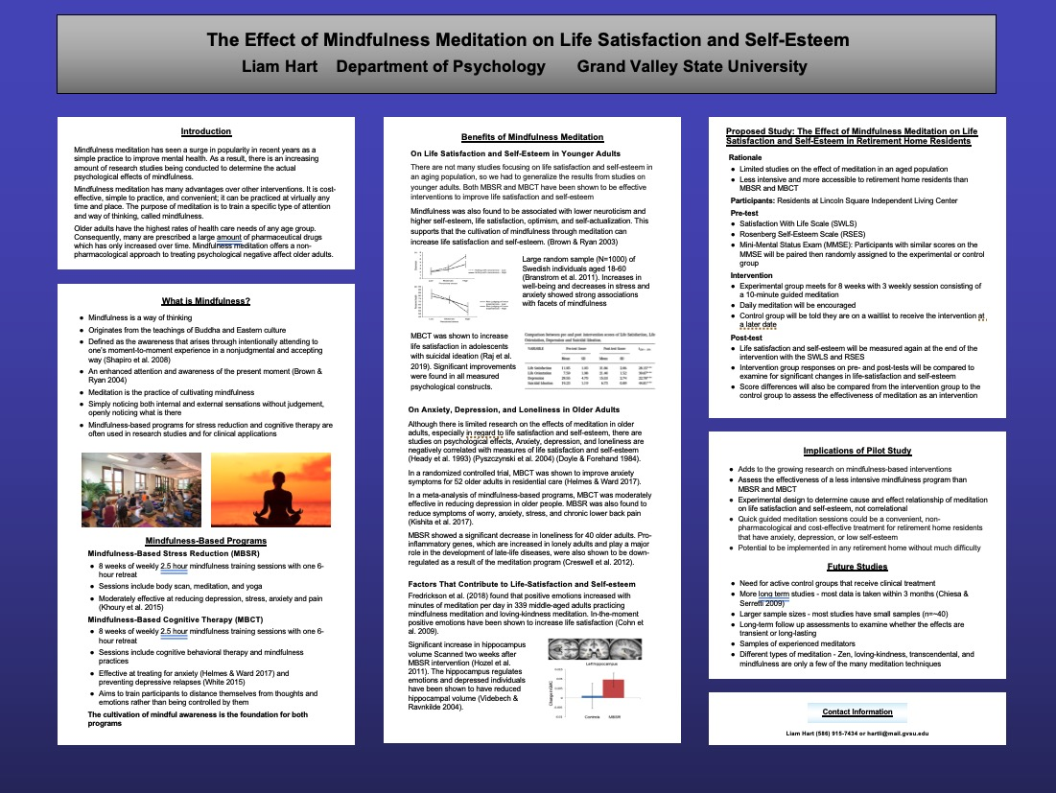
Art and Science of Aging Conference
First poster presentation!
Notes:
We obtained IRB approval to run the study and I presented the study proposal at the Art and Science of Aging conference
This is me presenting the poster

Slide 37
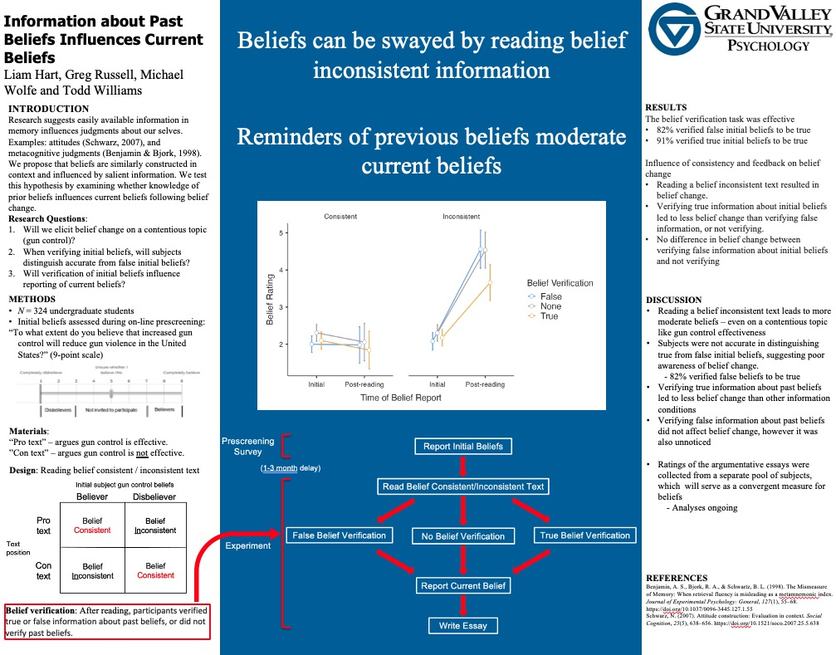
MPA
Notes:
I presented this poster at the Midwest Psychological Association Conference

Slide 38

Beyond
Worked at Planet Rock Climbing Gym Jan 2022
Poster presentation at Midwest Psychological Association Apr 2022
Oral presentation at Society for Text and Discourse Jul 2022
First authorship on manuscript published in Educational Gerontology Jan 2023
Author on manuscript submitted to Acta Psychologica Feb 2023
First authorship on manuscript submitted to Instructional Science Apr 2023
Starting as research project coordinator at Henry Ford Health Apr 2023
Notes:
After graduation, I moved back home and began working at a climbing gym. I planned on taking a gap year before entering a PhD program, so this would serve as my fun job. I also got super into rock climbing in my last semester at Grand Valley, and working at the nearest climbing gym (which was 35-40 minutes away from my hours) seemed to be the best way to immerse myself in the sport and solidify it as being a part of my life.

Slide 39
The Research Process
Hypothesis
Study design
Collecting data
Cleaning and analyzing data
Presenting results at conferences
Writing manuscript
Submission to academic journals (peer review)
Publication!
Notes:
While anyone can read this and have a loose understanding that this is the order of operations in research, it is essential to gain experience and actually go through the motions to have a true understanding of what needs to happen and why. Research is very slow and detail-oriented. There are many problems that can arise at each point in the process – not getting subjects, mistakes in data management and collection, learning new statistical methods, and the preparation of conferences posters and talks. And the paper hasn’t even begun to have been written!
Little tips like writing the methods/procedure as you do it are so important. I cannot imagine not doing that and having to retrace your steps and remember what was done a year or two later. Again, from my experience, the beginning to end of this process usually seems to take 1-2 years – and that is at a breakneck pace (if you are doing it all yourself or with a small lab).

Slide 40
Formulation of hypothesis
Formulation of hypothesis
Usually after a literature review (but sometimes before)
Professors are experts of a specific area
For example, text comprehension
As an undergrad or grad student, you’ve got some reading to do
Pick the area you want to become an expert in

Slide 41
Study design
Experimental conditions
Materials (can involve lots of writing and/or programming)
Measurement
Procedure
Notes:
Learn any type of programming – Python, JavaScript, etc.
ChatGPT may help a lot with materials

Slide 42
Collecting data
Obtain IRB approval for study
Lots of logistics, planning, and organization
In psychology, PSY 101 students are usually the subject pool
Otherwise, some incentive must be given for subjects ($$$)

Slide 43

Clean and Analyze Data
Cleaning and analyzing data using statistical software
Excel, SPSS, R, Python, Jamovi
Technical and important “hard” skill
Statistics are used for research in ALL disciplines
Academia likes RStudio
Notes:
Once upon a time, some professor told me that statistic would be a good thing to minor in for graduate school applications.
I did not fully understand why until my junior/senior year. Statistics are essential for all forms of research in all disciplines that use quantitative data.
There are many programs you can use. I would recommend Rstudio.
While the learning curve is higher than a point-and-click software (SPSS, Jamovi, Excel), it is valuable and you will probably have to learn it in grad school.
Aside from the statistical analyses, it is also really important to know how to clean and organize datasets.
You can only do statistics if the data is structured a certain way, and you need to get it that way or it is not gonna work out.

Slide 44
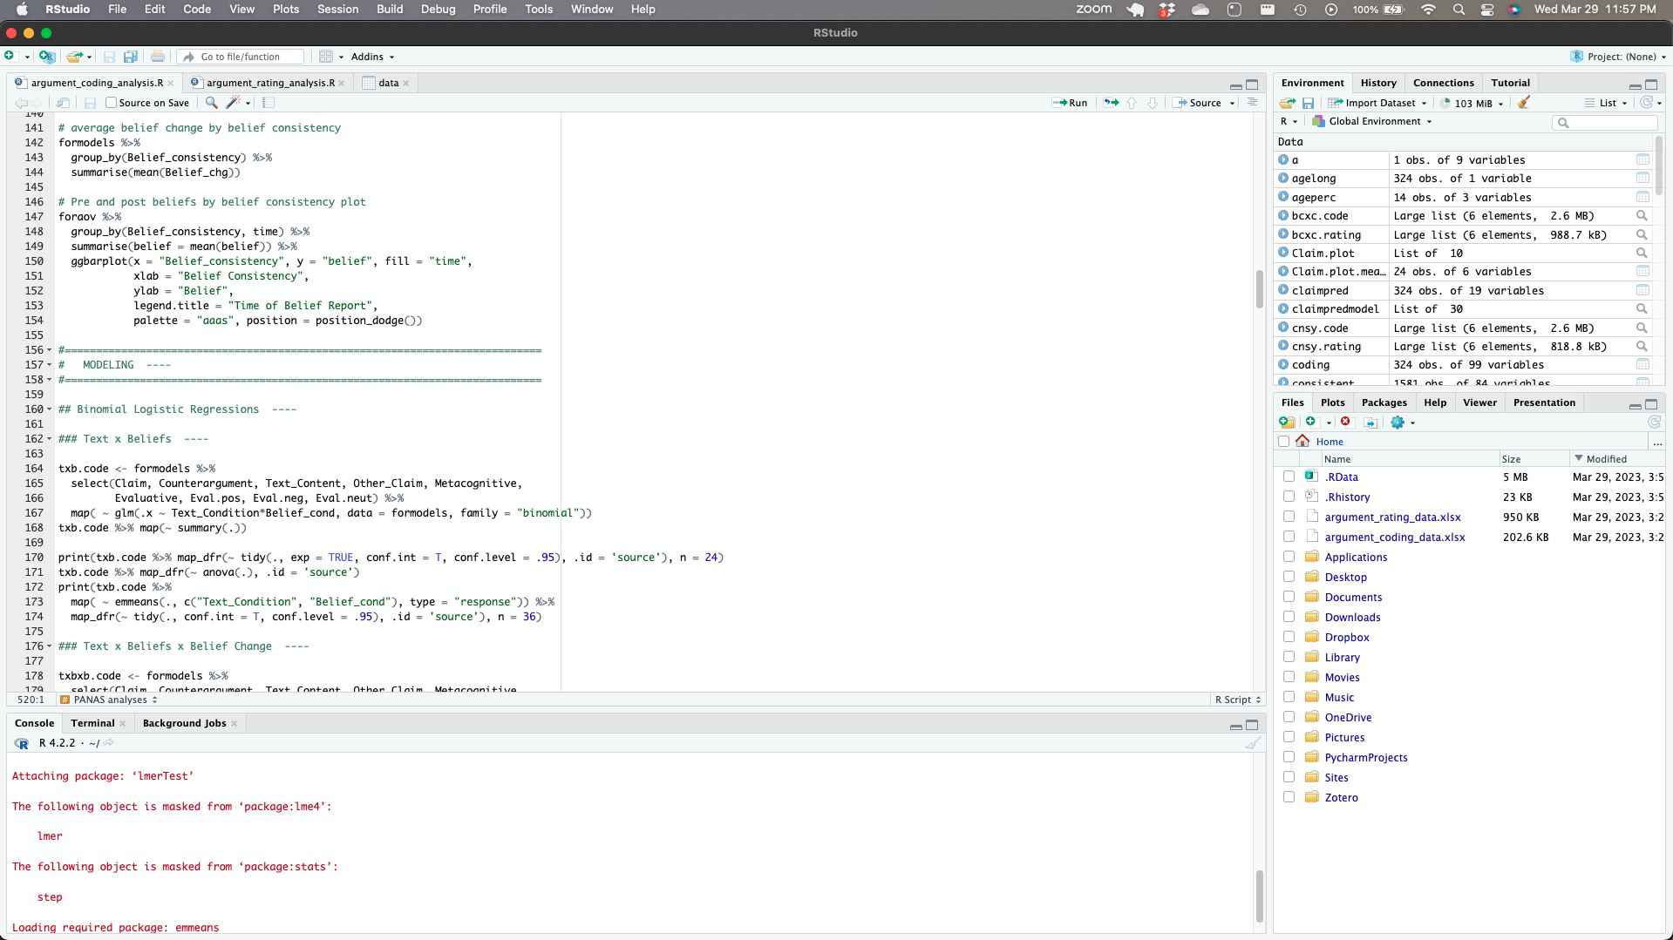
Notes:
Example R code I have posted on OSF for most recent submission

Slide 45
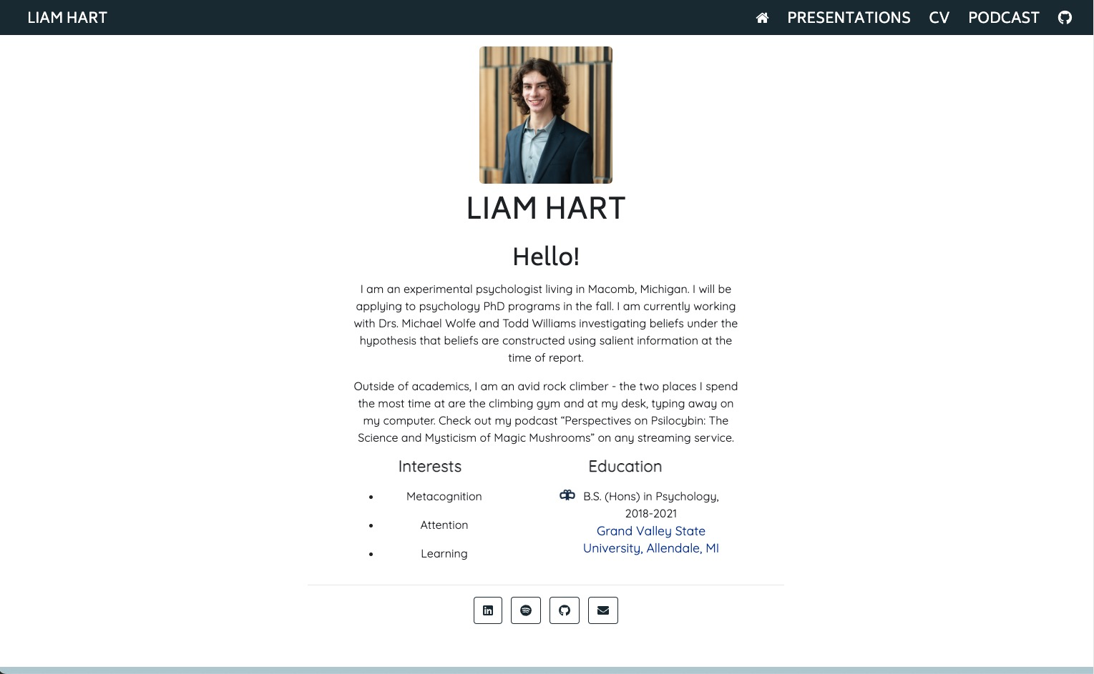
Outline
Notes:
Personal website made using Distill package in R

Slide 46
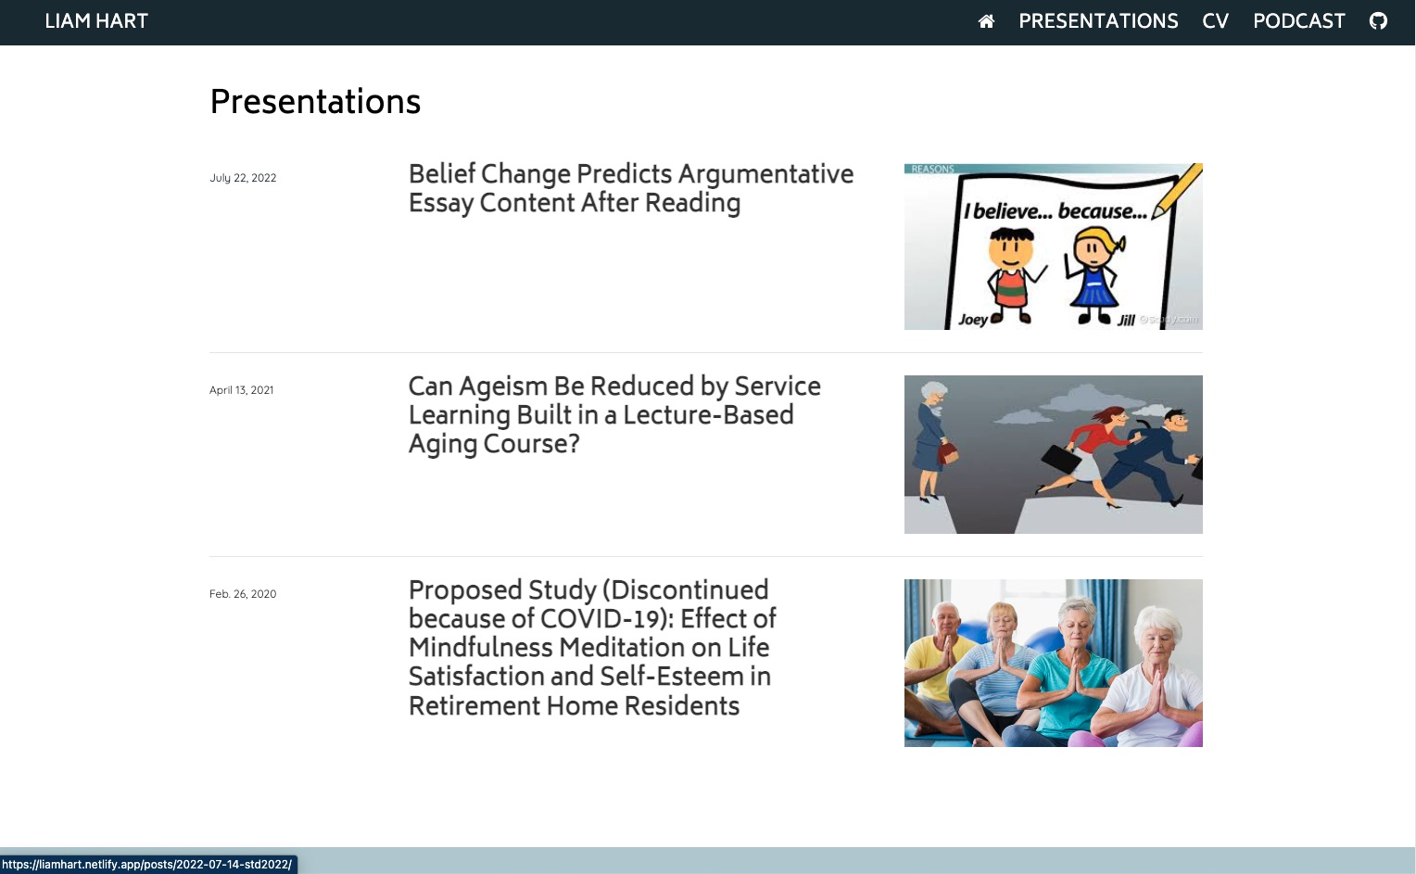
Notes:
Good way to showcase recorded presentations and publications – I actually need to update mine to include my publications

Slide 47
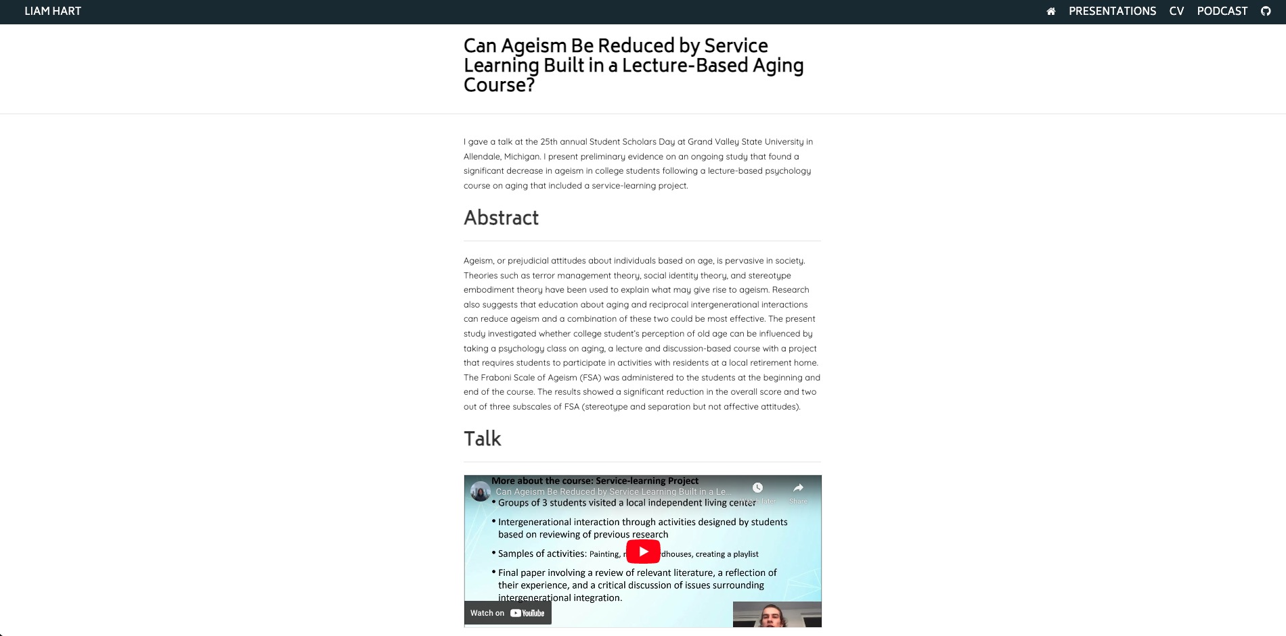

Slide 48
Dissemination of Findings (part 1)
Presenting results at conferences
Abstract
Poster
Slideshow for a talk
Conference presentations are like a rough draft of a manuscript
Summarizes findings
May not be as fleshed out as the final product (ie., title change)
Sometimes don’t even make it to the publication stage
Notes:
Conference presentations are the first step of disseminating research findings.
They are like a prelude to a paper that may or not be written.
Conference submissions start with an abstract, and the presentation itself can be either a poster or oral.
Oral is more coveted – there are 10x as many posters as oral presentation, but of course they take more work.

Slide 49
Dissemination of Findings (part 2)
Writing and submission of the manuscript
The most difficult and tedious part (in my opinion)
Like writing a research paper for class but it has to be 100% perfect
APA format
Cover letter to the editor
Anonymous and non-anonymous copies
Peer review takes a long time
~ 2 months after submission, then 2 months to revise…
Took 6 months to publish
Then, hopefully publication!
Notes:
Often think piece of writing could not be improved upon, then professor tears it apart – and this cycle repeats about 5 times.
Before this, I had always felt like a pretty good writer as a student. Technical/academic writing just takes a lot of practice and must be perfectly accurate, concise, and simple.
Imagine writing a research paper for class but it has to be 100% perfect, and you will probably think it is close to being done 5 times before you get a halfway decent draft.
Always looking for feedback from peers and other lab members.

Slide 50
PhD vs. Master’s
PhD trains you to be a researcher (funded, 3-7 years)
Master’s trains you to apply knowledge in a job (unfunded, 1-3 years)
IF GOAL IS TO GET A WELL-PAYING JOB QUICKLY
Master’s
Get an internship
Work experience is more important than research experience
IF GOAL IS RESEARCH
PhD
Undergraduate research experience is extremely important
Mentorship from faculty is invaluable
Notes:
It is no secret that a bachelors in psychology is not enough to get you an exclusive job
That is not to say you can’t be successful or make a lot of money without higher education – many sales, marketing and HR roles do very well
However, you do not have to have a bachelors in psychology to enter those fields
To “stay in psychology”, the usual path is to go for a masters or a PhD, but which one is right for you?
First consideration is how long are you willing to go for school? A PhD takes longer – however, it is fully funded
Second consideration is what are your career goals. Pretty simple from here – if you want a job quickly, get a masters.
Internships are the way to go since work experience is king. Companies are looking to see that you can apply the skills you’ve gained in a job.
If the goal is research, go for a PhD. Academic research experience is king here. To do so, you must work with faculty who will also provide invaluable mentorship.
I cannot overstate how important their mentorship and perspective is. They are an academic and you will be training to become an academic.
If you are looking for a job go to the career center. If you are looking to further your education and be trained as a researcher go to your professors.

Slide 51
THANK YOU!
Please feel free to contact me with any questions
hartli@mail.gvsu.edu

